Slide 1
Wumpus World game
Report

Slide 2
Knowledge base
In the context of a Wumpus World game or other artificial intelligence applications, a "knowledge base" refers to a structured collection of information that an agent or system uses to reason, make decisions, and respond to its environment. The knowledge base contains facts, rules, and relationships that the agent has acquired or inferred during its interactions with the world.
Let's break down the key components of a knowledge base in the context of a Wumpus World game:
Facts: These are concrete pieces of information about the state of the environment. For example, the presence of a pit at a certain location, the position of the Wumpus, the location of gold, etc.
Rules: These are logical statements or conditions that the agent can use to derive new facts or make decisions. For instance, a rule might state that if the agent perceives a breeze, there might be a pit nearby.
Inference: The process of drawing logical conclusions or making deductions based on the facts and rules in the knowledge base. In a Wumpus World game, the agent might infer the presence of a pit if it perceives a breeze.
Dynamic Updates: The knowledge base is dynamic and gets updated as the agent interacts with the environment. For example, if the agent moves to a new location and doesn't perceive a breeze, it can update its knowledge base to indicate that there is no pit in the new location.

Slide 3
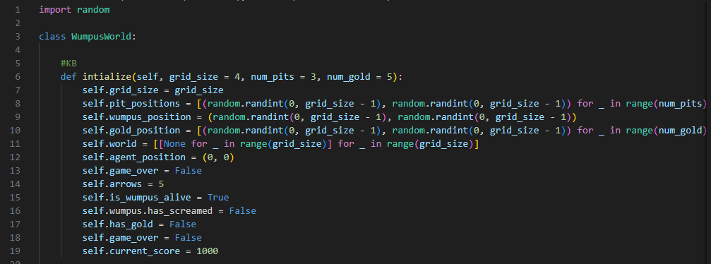

Slide 4
Inference engine
An inference engine is a crucial component in artificial intelligence systems, including those used in logic-based systems and rule-based systems. It is responsible for deriving logical conclusions or making decisions based on the information (facts and rules) stored in the knowledge base. In the context of a Wumpus World game or other reasoning tasks, the inference engine processes the available information to infer new facts, update the knowledge base, and guide the behavior of the intelligent agent.
Here are the key components and functionalities of an inference engine:
Pattern Matching: The inference engine matches the observed or known facts in the knowledge base with the conditions specified in the rules. It identifies patterns that match the current state of the environment.
Rule Evaluation: Once the relevant rules are identified through pattern matching, the inference engine evaluates these rules to determine which actions or conclusions should be taken. Rules often involve logical conditions that, when satisfied, trigger specific actions.
Inference: The engine draws logical conclusions based on the matched rules and the current state of the environment. These conclusions may include new facts that are added to the knowledge base or decisions on the next actions the agent should take.
Uncertainty Handling: In many real-world scenarios, there is uncertainty or incomplete information. The inference engine may be designed to handle uncertainty by using probabilistic reasoning or fuzzy logic, allowing the agent to make informed decisions even when it doesn't have complete information.
Conflict Resolution: In cases where multiple rules or pieces of information conflict with each other, the inference engine may prioritize or resolve conflicts based on predefined rules or heuristics.

Slide 5
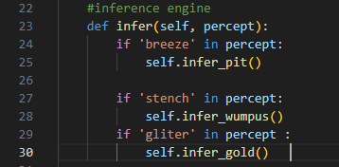

Slide 6
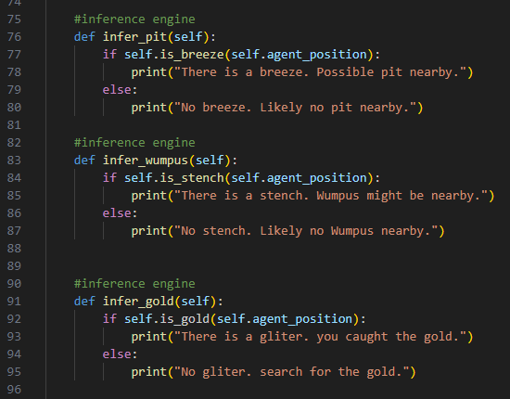

Slide 7
Agent Function
The agent function is a critical part of an intelligent agent in artificial intelligence. It represents the strategy or decision-making process that the agent employs to choose actions based on its current knowledge and perceptions of the environment. In the context of a Wumpus World game or any similar scenario, the agent function dictates how the agent should behave, move, and interact with the environment.
Here are key aspects and functionalities of an agent function:
Perception: The agent function incorporates information from the environment received through sensors or perceptions. This includes cues such as breezes, stenches, glitter, and other observable features in the game.
Knowledge Base Interaction: The agent function interacts with the knowledge base, using the information stored within it to make informed decisions. It may use rules and logic to infer additional information from the knowledge base.
Action Selection: Based on the perceived information and the current state of the knowledge base, the agent function selects the next action to take. Actions can include moving to a new location, shooting an arrow, grabbing gold, or performing other game-specific tasks.
Decision-Making: The agent function may involve decision-making algorithms that prioritize actions based on certain criteria. For example, the agent might prioritize moving to a safe, unexplored location over taking a risky move.
Goal-Oriented Behavior: The agent function is often designed to work towards achieving specific goals or objectives. In the case of a Wumpus World game, the goals might include finding gold, avoiding hazards like pits and the Wumpus, and safely navigating the environment.
Adaptability: The agent function may be adaptable, allowing the agent to adjust its strategy based on changes in the environment or new information gathered through perceptions.

Slide 8
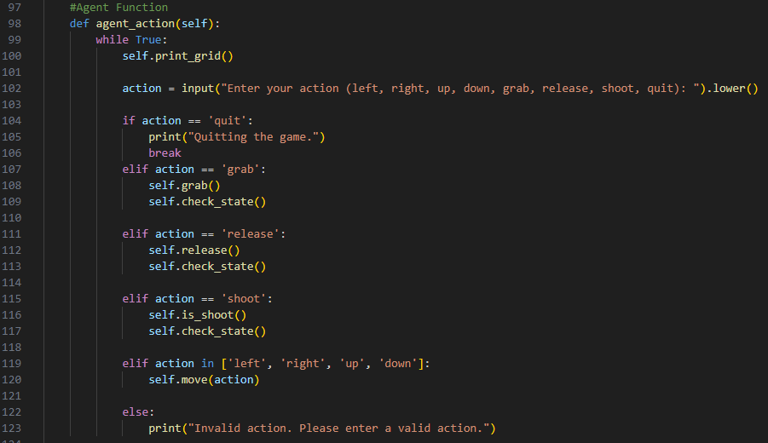

Slide 9
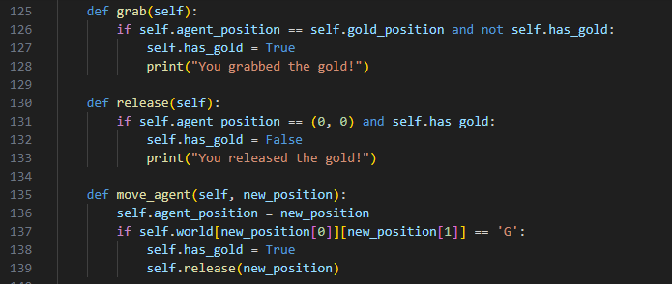

Slide 10
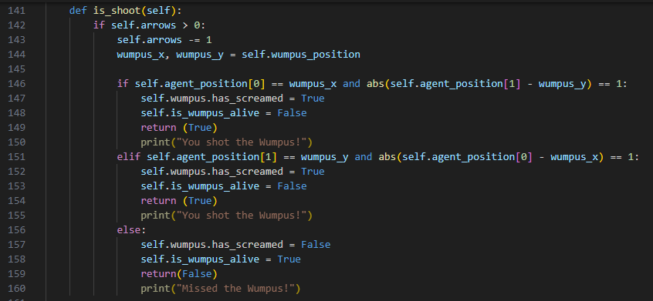

Slide 11
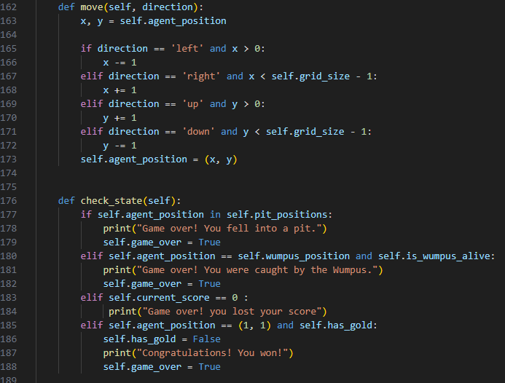

Slide 12
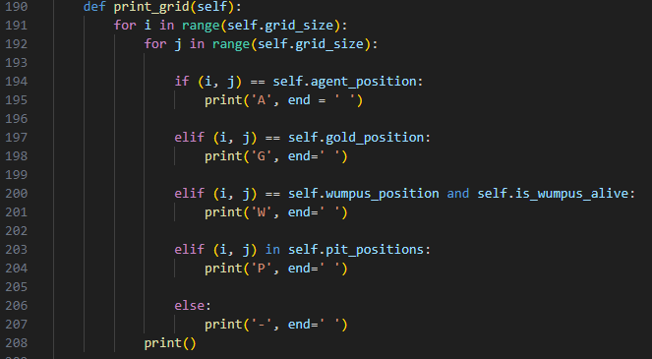

Slide 13
score
In the context of a game, including the Wumpus World game, a "score" is a numerical representation of a player's or an agent's performance or success in the game. The score is often used to evaluate how well the player or agent is doing based on certain criteria and objectives set by the game rules.
Here are some common aspects related to the concept of score in a game:
Objective Measurement: The score is typically designed to quantify the player's progress or achievement in meeting the objectives of the game. In the case of the Wumpus World, objectives might include finding gold, avoiding hazards like pits and the Wumpus, and successfully navigating the environment.
Scoring Rules: The game defines rules that determine how the score is calculated. Different actions and outcomes in the game may contribute positively or negatively to the score. For example, picking up gold might increase the score, while falling into a pit might decrease it.
Feedback Mechanism: The score serves as a feedback mechanism for the player or agent. It provides immediate information about the consequences of their actions, helping them understand how well they are performing in the game.
Winning and Losing Conditions: In many games, including Wumpus World, the score is tied to winning and losing conditions. The player may need to achieve a certain score or complete specific objectives to win the game. Conversely, falling below a certain score or violating certain rules may result in losing the game.
Dynamic Updates: The score is often dynamically updated as the player or agent takes actions in the game. Positive or negative events trigger changes in the score, reflecting the impact of those events on the player's overall performance.

Slide 14
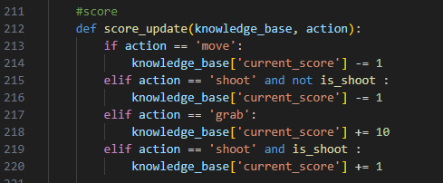

Slide 15
Visualization
Visualization in the context of a Wumpus World game, or any computer program, refers to the graphical or textual representation of information for users to comprehend and interpret. In a Wumpus World game, visualization is crucial for users or developers to understand the state of the game, the agent's movements, and the outcomes of actions.
Here are key aspects related to visualization in a Wumpus World game:
Game State Representation: Visualization helps represent the current state of the game, including the positions of the agent, the Wumpus, pits, gold, and other relevant elements. It provides a snapshot of the environment at a particular point in time.
Action Display: Visualization allows users to see the consequences of the agent's actions. For example, if the agent moves to a new position, the visualization should update to reflect the change in the agent's location.
Percept Display: It shows what the agent perceives in its environment. If the agent senses a breeze, stench, or glitter, the visualization can convey this information to the user.
Score Display: Visualization often includes the display of the current score. Users can see how their actions impact their overall performance in the game.
Dynamic Updates: Visualization should dynamically update as the game progresses. Whether the agent moves, perceives something, or takes any action, the visualization should reflect these changes in real-time.
User Interface (UI): Visualization is often presented through a user interface that users can interact with. This could be a graphical user interface (GUI) or a console-based interface, depending on the design of the game.

Slide 16


